Slide 1
Building
Better
Homes

Slide 2
Q?
What kind
of homes
do our
children
need?

Slide 3
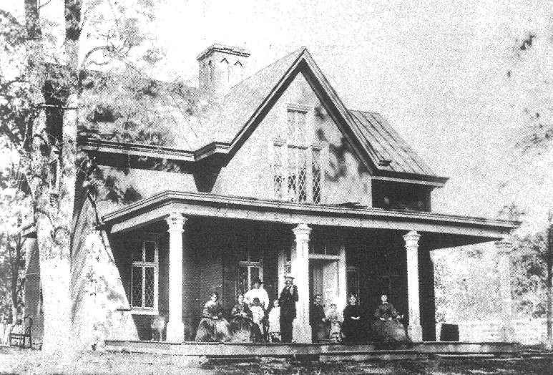
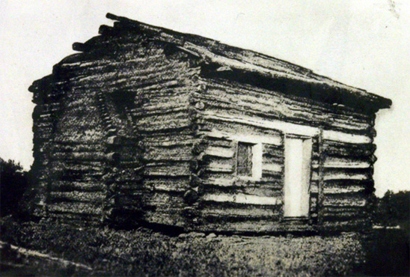

Slide 4
The crying need in our culture is not better houses… it’s better homes.

Slide 5
Proverbs
15:16-17
&
17:1

Slide 6
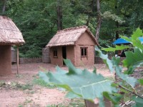


2 Ptr. 3
“seeing that all these things shall be dissolved…”

Slide 7
2 Ptr. 3
“seeing that all these things shall be dissolved…”

Slide 8
Gen.2:24
Josh. 24.15
Matt. 7.24-26
“Let marriage be had in honor among all and let the bed be undefiled, for fornicators and adulterers God will judge.” Heb.13:4

Slide 9
Homes
(like houses) need work
& maintenance

Slide 10
“disposable-marriage” in a disposable culture
“I think God wants me to be happy”
“I thought things would be different”
“I want to do what I want to do”
“It’s not good for the kids to see us unhappy”
“I’m not in love anymore”
Luke 16.18; Mark 10; Matt. 19
1 Cor. 7; Malachi 2:13-16

Slide 11


a lesson from cuban cars
By Zahav511 - Own work, CC BY-SA 3.0, https://commons.wikimedia.org/w/index.php?curid=23452995
CC BY-SA 3.0, https://commons.wikimedia.org/w/index.php?curid=1042507
By MiltonPoint - Own work, CC BY-SA 4.0, https://commons.wikimedia.org/w/index.php?curid=38351278

Slide 12
the relative importance of temporary threats & eternal threats…

Slide 13
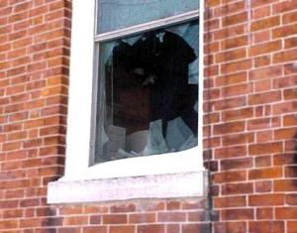
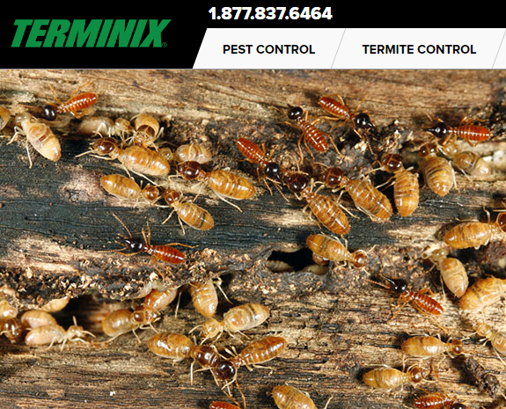
What would I do …?

Slide 14
What would I do …?
If I found your well or water line was toxic?

Slide 15
on a spiritual & moral level…
…am I letting toxic filth infiltrate my home?

Slide 16
Godliness does not come from taking our cues from the world
Rm.12.1-2

Slide 17
Gen. 2.18, 24 -leave & cleave
Gen.3.13-19; 1 Tim. 5.8
  provide for physical needs
Deut.6.1-9; Eph.6.4
  provide spiritual leadership
Eph. 5.25, 28-29
  provide leadership generally
  a sacrificial & serving leader : Eph. 5.25
husbands

Slide 18
Eph 5:25, 28-31, 33 ESV
25 Husbands, love your wives, as Christ loved the church and gave himself up for her, ...
28-31 In the same way husbands should love their wives as their own bodies. He who loves his wife loves himself. For no one ever hated his own flesh, but nourishes and cherishes it, just as Christ does the church, because we are members of his body.
31 "Therefore a man shall leave his father and mother and hold fast to his wife, and the two shall become one flesh." ... 33 However, let each one of you love his wife as himself, and let the wife see that she respects her husband.
husbands

Slide 19
Eph 5:25, 28-31, 33 ESV
25 Husbands, love your wives, as Christ loved the church and gave himself up for her, ...
28-31 In the same way husbands should love their wives as their own bodies. He who loves his wife loves himself. For no one ever hated his own flesh, but nourishes and cherishes it, just as Christ does the church, because we are members of his body.
31 "Therefore a man shall leave his father and mother and hold fast to his wife, and the two shall become one flesh." ... 33 However, let each one of you love his wife as himself, and let the wife see that she respects her husband.
husbands

Slide 20
Eph 5:25, 28-31, 33 ESV
25 Husbands, love your wives, as Christ loved the church and gave himself up for her, ...
28-31 In the same way husbands should love their wives as their own bodies. He who loves his wife loves himself. For no one ever hated his own flesh, but nourishes and cherishes it, just as Christ does the church, because we are members of his body.
31 "Therefore a man shall leave his father and mother and hold fast to his wife, and the two shall become one flesh." ... 33 However, let each one of you love his wife as himself, and let the wife see that she respects her husband.
husbands

Slide 21
wife
Eph. 5.22-24
  Wives, submit to your own husbands, as to the Lord. For the husband is the head of the wife even as Christ is the head of the church, his body, and is himself its Savior. Now as the church submits to Christ, so also wives should submit in everything to their husbands.

Slide 22
LOVE
RESPECT

Slide 23
Eph. 5 to the to the wife: husband: wife: LOVE HER FOLLOW HIM

Slide 24
REMEMBERING YOUR VOWS:
“love and cherish” Eph.5.28-29
“honor” 1Ptr.3.7
“to her and her alone” Job.31.1; Pr.5; Mt.5
husbands

Slide 25
Thou shalt have no other gods before me.
Thou shalt not make
a graven image
Thou shalt not take the name of the LORD thy God in vain
Remember the sabbath
Honour thy father and thy mother
Thou shalt not
kill.
Thou shalt not commit adultery
Thou shalt not
steal.
Thou shalt not
bear false witness
Thou shalt not
covet
Thou shalt Not
coMMIT ADULTERy

Slide 26
Thou shalt have no other gods before me.
Thou shalt not make
a graven image
Thou shalt not take the name of the LORD thy God in vain
Remember the sabbath
Honour thy father and thy mother
Thou shalt not
kill.
Thou shalt not commit adultery
Thou shalt not
steal.
Thou shalt not
bear false witness
Thou shalt not
covet
pornography
Matt. 5.27-30

Slide 27
an analogy: a man
& a woman
& a garden

Slide 28

RESPECTING
BOUNDARIES
clothing
communication
compliments
contact
companionship
closeness
imagination
intimacy
love
desire
loyalty

Slide 29
HEB.13:4
Let marriage be had in honor among all
MAL. 2:14 NKJV
the LORD has been witness
Between you and the wife of your youth… she is your companion
And your wife by covenant.

Slide 30
Proverbs
5
6
7

Slide 31
wife
Eph. 5.22-24
  Wives, submit to your own husbands, as to the Lord. For the husband is the head of the wife even as Christ is the head of the church, his body, and is himself its Savior. Now as the church submits to Christ, so also wives should submit in everything to their husbands.

Slide 32
husband & wife
1 Peter 3

Slide 33
wife
Titus 2.3-5
  older women teach the younger women:
  “to love their husbands, to love their children, to be sensible, pure, workers at home, kind, being subject to their own husbands”
Gen.3:16-19; Prov.31
1Tim.5.14; Titus 2.5

Slide 34
wife
Proverbs 31.10-31
an excellent wife, her worth is far above rubies [10]
the heart of her husband trusts in her [11]
she does him good and not evil [12]
she stretches out her hands to the needy [20]
she looks well to the ways of her household [27]
strength and dignity are her clothing [25]
law of kindness is on her tongue [26]

Slide 35
husband & wife
1Cor.7.
defraud not one another
husband
wife
“one flesh” God’s plan / fund. & beneficial
considerate (1 Cor.7; Mt. 7.12; Php.2 )
secure (Pr.31 / Pr.5-7)
impassioned (Prov.5)
loving (Eph.5/ Titus 2)

Slide 36
communication
communication
Col.
3.19
Prov. 21.9
27.15

Slide 37
tension,
frustration,
irritableness
effectiveness

Slide 38
speaking with kindness
Eph. 4.15 speaking the truth in love
Prov.25:15 a soft tongue breaks the bone
Prov.15:1 A soft answer turneth away wrath: but grievous words stir up anger
Prov. 31:26
Col. 3:19
Mt. 7:12
PROVERBS 18:21

Slide 39
specific area …
“sorry apologies“ vs. sorrow & apology

Slide 40
apologies
Perhaps I made a mistake
the minimizing apology
the accusation apology
the “hypothetical” apology
the “I’m sorry, but…” apology
the angry apology
Maybe my reaction wasn’t the best
Well, no one’s perfect after all
i.o.w.:
NO BIG DEAL. MAYBE I WASN’T PERFECT.

Slide 41
apologies
I’m sorry you got so upset over that
the minimizing apology
the accusation apology
the “hypothetical” apology
the “I’m sorry, but…” apology
the angry apology
I’m sorry you were so bothered by that
I’m sorry you took it the wrong way
i.o.w.: HERE’S YOUR APOLOGY: SORRY YOU MESSED UP, BUT IT’S YOUR FAULT

Slide 42
apologies
If I may have made a mistake
the minimizing apology
the accusation apology
the “hypothetical” apology
the “I’m sorry, but…” apology
the angry apology
If I did anything that may have appeared to be wrong
i.o.w.: I’M ADMITTING NOTHING (and likely did nothing). BUT SUPPOSING EVEN IF I DID, LET’S CONSIDER IT APOLOGIZED FOR

Slide 43
apologies
Well I’m sorry, BUT IF YOU HADN’T…
the minimizing apology
the accusation apology
the “hypothetical” apology
the “I’m sorry, but…” apology
the angry apology
I’m sorry, BUT YOU WERE THE ONE…
I’m sorry, BUT I ONLY
REACTED THAT WAY
BECAUSE YOU…
i.o.w.: OK, there’s your apology. NOW TO THE REAL PROBLEM: YOU.

Slide 44
apologies
So I’m sorry,
OK???
the minimizing apology
the accusation apology
the “hypothetical” apology
the “I’m sorry, but…” apology
the angry apology
FINE! I’m sorry then. Are you satisfied?
i.o.w.:
Ok- I said the words. Now get off my back!

Slide 45
apologies
the minimizing apology
the accusation apology
the “hypothetical” apology
the “I’m sorry, but…” apology
the angry apology
the apology of the prodigal son
Lk.15:21

Slide 46
throwing jabs
“My mistake. I should have learned by now not to expect too much.”
“I shouldn’t blame you. You get it honestly enough from your [Dad/Mom/brother/sister].”
“I should have listened to my mother when she warned me about you.”
Prov.12:18 nasb
“There is one who speaks rashly
like the thrusts of a sword,
But the tongue of the wise brings healing.”

Slide 47
“Let no corrupt speech proceed out of your mouth, but such as is good for edifying as the need may be, that it may give grace to them that hear.”
Eph.4:29 asv

Slide 48
Nurture?
Or Neglect?
Build up?
Or tear down?
Grow together?
Or grow cold?
Family

Slide 49
CHILD TRAINING

Slide 50
Biblical examples of parenting
(good and bad)
(-) choice of environ. Lot Gen.13:12-13
(-) deceit & favoritism R & I / J. G.25 & 37
(-) not restraining Eli 1S.2:22-23/ 3.13
(-) “will not withhold” David 2Sam.13/ 1K.1.6
(+) lasting influence Jonadab Jer. 35:1-19
(+) raised in the Word L > E > T 2Tim.1:5; 3:15

Slide 51
Proverbs 22.6
ESV
“Train up a child in the way he should go,
Even when he is old, he will not depart from it”

Slide 52
Prov. 29:15
NET
A rod and reproof impart wisdom, but a child who is unrestrained brings shame to his mother.

Slide 53
CHILD TRAINING
Proverbs 22.6 “Train up a child in the way he should go, even when he is old, he will not depart from it”
or Judith Harris:“Do Parents really matter?”
Time issues:
a garden

Slide 54


?

Slide 55
PARENTS
It takes the babies about 2 weeks to leave the nest, or "fledge," and then they usually stay with their parents for two or three weeks after that.
Journey North American Robin
Proverbs 22.6 “Train up a child in the way he should go, even when he is old, he will not depart from it”
or Judith Harris:“Do Parents really matter?”
Time issues:
a garden
cat, bird
Deut. 6.7; Eph.6.4
the importance of starting early
10 to 12 weeks

Slide 56
early child training

Slide 57
LESSON # 1: basic vocabulary:
No
No

Slide 58
EARLY TRAINING & “NO”
The importance of “no” [cf. Gen.2; Ex. 20]
respect & compliance for the prohibitory “no”
if you don’t mean it, don’t say it, and if you do mean it, enforce it - Mt.5.37

Slide 59
VOCABULARY TEST:
What does “no” mean to my child?
Tantrum
time
No
The defense attorney may now cross examine
No
No
Don’t do it while Mom or Dad are watching
No
No

Slide 60
RESPECT
FOR
AUTHORITY
I WON’T ALWAYS GET MY WAY
BEHAVIOR
IS MORE IMPORANT THAN DESIRE
SELF
DENIAL
/
SELF
CONTROL
No
No

Slide 61
EARLY TRAINING & “NO”
important foundation:
learning to submit to an earthly father prepares the child for submission to a far more important Father.

Slide 62
EARLY TRAINING & “NO”
respect & compliance for
prohibitory “no”
zero tolerance for
defiant & rebellious “no”

Slide 63
avoiding upside down homes

Slide 64
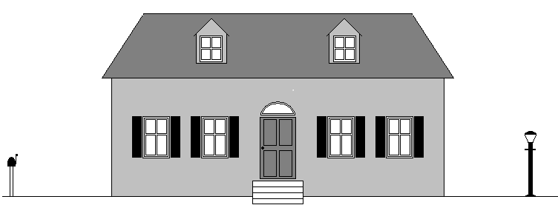
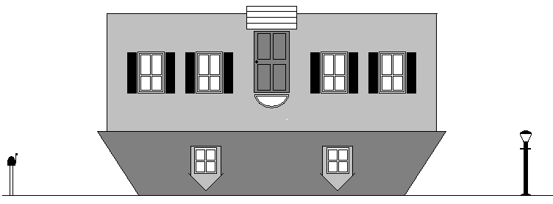

Slide 65
UPSIDE DOWN HOMES (M.&.D.Pearl?)
Child centered homes vs. God centered homes:
Too many children view the home, the parents, the food, etc., as merely a means to an ends: to satisfy and please the child.
The child makes his demands and manipulates the parents via tantrums and repeated misbehavior.
Parents bow to the will of the child in efforts to placate and appease his whims and dissatisfactions, or suffer through increased strife and conflict when they cannot.
The home is like a house built upside down.

Slide 66
The child needs to understand:
CHILD
PARENTS
GOD
GOD
father
mother
child

Slide 67
ROLES
Josh. 24.15
Eph.5.25
1Ptr. 3; 1Tm.5.14
Eph.6

Slide 68
a child untrained . . . a.) 4 yr. old b.) breakfast
Prov. 29:15
The rod and reproof give wisdom,
but a child left to himself brings
shame to his mother.

Slide 69
Prov. 29:15 ESV
The rod and reproof give wisdom,
but a child left to himself brings
shame to his mother.

Slide 70
some common mistakes to avoid
parenting pitfalls

Slide 71
1. failing to discipline...
He who spares his rod hates his son, but he who loves him disciplines him diligently Prov.13.24
Discipline your son while there is hope, and do not desire his death Prov. 19.18
Foolishness is bound up in the heart of a child; the rod of discipline will drive it far from him Prov. 22.15

Slide 72
1. failing to discipline...
Do not hold back discipline from the child, Although you strike him with the rod, he will not die Prov. 23.13
The rod and reproof bring wisdom, but a child who gets his own way brings shame to his mother Prov. 29.15
Correct your son, and he will give you comfort; he will also delight your soul Prov. 29.17
(illustration / 4 yr. old)

Slide 73
2. Rewarding misbehavior
Why do children throw tantrums?
lowering the bar / accom. & facilitating misbehavior
letting a child get “his way” is not doing him a favor, it will spoil him
letting a child get his way will not satisfy him, it will spoil him [imp.of boundaries/ playground.ex.]
the difference between a boy and a pig
“The rod and reproof bring wisdom, but a child who gets his own way brings shame to his mother” Prov. 29.15

Slide 74
3. Expecting misbehavior
Not talking about wanting misbehavior, hoping for, or preferring misbehavior…
but expecting misbehavior
  “Oh, we can’t take him to the restaurant”
  “There’s no way Jr’s going to sit still for an hour”
  “Well after that sugar, he’s going to be impossible”
  “Oh, I’ll never get him to eat that”
  “Sorry, my son’s not much of a sharer”
“Foolishness is bound up in the heart of a child; the rod of discipline will drive it far from him” Pr.22.15

Slide 75
If you expect tantrums, you will get them.
If you expect dishonesty, you will get it.
If you expect bad attitudes, you will get it. but if you really EXPECT the opposite, and require and TRAIN for the opposite, you will GET the opposite.
as a general rule: you get what you expect

Slide 76
4. failing to be consistent...
“He who spares his rod hates his son, but he who loves him disciplines him diligently” Pr.13.24
child pscyh. on “playing the odds”
lottery analogy: people keep buying tickets when there’s a chance of it paying off. Eliminate all lottery winnings, and people would quit buying tickets. Eliminate occasional pay-offs, and let the child realize the lottery is shut down.
“No parking” illustration (next slide)

Slide 77

Imagine a city that treated “No Parking” violations with the following sequence of responses (and everyone knew how the system worked):
10 minutes:
Please do not park here
20 minutes:
We asked you not to park here
30minutes:
I really mean it, do not park here
40 minutes:
Don’t make me tell you again
50 minutes:
I’m going to start counting to 10
60 minutes:
OK, now you’re in trouble !
$ 50 FINE
What would those no parking areas be filled with?

Slide 78
5. Thinking “I don’t have time…”
Like saying “I don’t have time to get rid of lice”
Child training time is well invested time, and saves time
“All discipline for the moment seems not joyful, but sorrowful, yet … afterwards it yields the peaceful fruit…” Heb.12.11
“He who spares his rod hates his son, but he who loves him disciplines him diligently” Prov.13.24

Slide 79
6. failing to control self...
proper motivation: Prov.13.24 “he who loves him disciplines him diligently”
discipline vs. abuse
  discipline vs. YELLING!!
      “expert” advice [?]
Why won’t he obey??? [
  “What’s wrong with you?” “I don’t know why you won’t do right!”
the vase test (see next slide)

Slide 80
THE VASE TEST set up: a.) Jr. bounces a ball off the wall b.) Mom says: “Jr., don’t throw that ball in the house” c.) Jr. looks at mom, heard her; throws the ball again anyway.
scenario A:
nothing broken
scenario B:
antique vase is shattered
Reaction:
No big deal.
Mom says,
“Jr., I asked you not to do that.”
Reaction:
Seeing her son’s willful defiance & disobedience, Mom takes this very serious and he is punished.
WHY?
Reaction:
No big deal. Mom says, “Jr., I asked you not to do that” ?
Reaction:
Jr’s in BIG trouble!! NOW he’s going to get it! This is VERY serious.
WHY?

Slide 81
3 C’s
CALM, CONSISTENT,
&
IN CONTROL

Slide 82
7. Training them to disrespect instructions given calmly
illustration: junior & bedtime (Jr. ignores first few instructions, only obeys once she looses her temper and yells)
Mom has a talk with Jr.: apologizes (for yelling) > inform Jr. of new policy (instruction given in normal voice, punishment if not obeyed) > follow through
The parents’ choice:
  they never obey
  they obey after you scream
  Or only after saying it over & over & over
  Or the 1st time, and to calm instructions (w/o yelling, nagging, badgering, etc.)

Slide 83
8. fathers “discouraging,” “provoking to wrath”
“Fathers, provoke not your children, that they be not discouraged” -Col. 3.21
“fathers, provoke not your children to wrath: but nurture them in the chastening and admonition of the Lord” -Eph.6.4
criticism … or nothing
expecting talents beyond their capacity
fluctuating boundaries based on your mood [Illust.: cattle fence]

Slide 84
9. failing to parent with joy
rejoice in the wife of your youth. Prov. 5.18
The father of the righteous will greatly rejoice; And he ...will have joy of him. Let your father and your mother be glad, And let her rejoice who gave birth to you. Prov. 23.24-25
A joyful heart makes a cheerful face, But when the heart is sad, the spirit is broken... a cheerful heart has a continual feast… Better is a dish of vegetables where love is Than a fattened ox served with hatred. Prov. 13.15-17nasb
the law of kindness is on her tongue. Prov.31.26
A joyful heart is good medicine, but a crushed spirit dries up the bones. Prov. 17.22esv
Ga.5.22 Love, Joy, Peace…

Slide 85
10. failing to use rod AND reproof
Just rod? [learns… what?]
Just reproof? [kid at walmart]
value in “the lecture”
  conscience
  anticipation
“The rod and reproof bring wisdom, but a child who gets his own way brings shame to his mother” Prov. 29.15

Slide 86
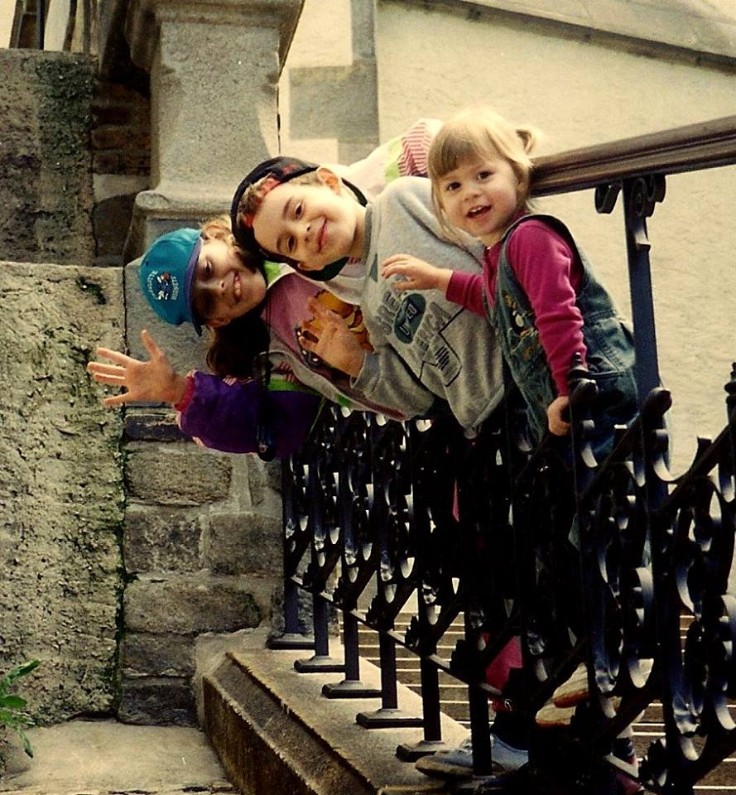
11. Settling for situation control instead of training the child.
twinkie brat - Michael & Debbie Pearl / To Train up a Child
BRIANNE & THE CAR SEAT ILLUSTRATION
A mom’s comment on this point: “live altering experience” in 2 or 3 days: improved behavior / happier child
MERE CONTROL vs. TRAINING (& what results?) “They’re not going to do that under my roof” is not enough. Train them. Teach them self-control so they will behave themselves under any roof.
“TRAIN up a child in the way he should go, even when he is old he will not depart from it” Pr.22.6 (not just “control”)
TRAIN THEIR HEARTS
a little boy, made to sit down, had this to say: “I’m still standing up on the inside!” … then job’s not done!

Slide 87
12. Mistaking “taking them to church” for “bringing them up in the nurture and admonition of the Lord”
Eph. 6.4
Deut. 6.7
  “You shall teach them diligently to your sons and shall talk of them when you sit in your house and when you walk by the way and when you lie down and when you rise up”

Slide 88
13. thinking “if we don’t allow this, they might rebel and leave the church”
what good is being “in church” if they aren’t in the Lord? -Rev.3.14ff
“do you not know that friendship with the world is hostility toward God?” -James 4.4
entertainment? attire? interests?
And start training EARLY

Slide 89
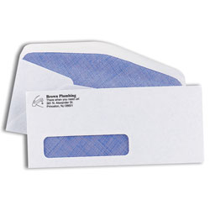
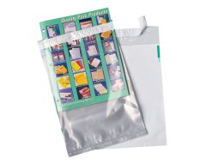
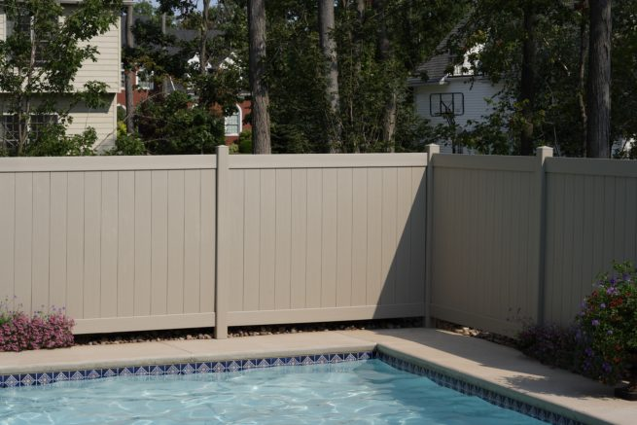

clothing choices:
clothing choices…
Gen. 3
Ex. 28:42
1 Tm. 2:9
Jn. 21.7
Pr. 7.10
1 Ptr. 3.3

Slide 90
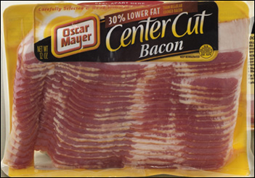

clothing choices…
exposed cleavage?
exposed undergarments?
tight pants?
tight tops?
high slits?
bare midriff?
bare thighs?

Slide 91
14. assuming cultural norms : “terrible 2’s” > “rebellious teens”
culturally common: >rebellious teens
also common: >ungodly adults
Josiah 2 Chron. 34.1-3
Timothy Acts 16:1-3 / cf. 1Tim.4.12
Note: wise parenting & the consideration of “trajectory” [cf: Jonadab in Jer.35 / Lot in Gn.13]
Expect Train Guide Eccl.12.1

Slide 92
15. Going into defense mode when our children are wrong
Defending
Denying
Redirecting blame
1Tim.5.21 “without partiality”
Isaiah 5.20 “woe to them that call evil good, and good evil”
If you start a pattern of bailing out, don’t be surprised it they come to expect it.

Slide 93
16. Failing to train humility
Proverbs 6 (first abomination)
being aware of a culture that celebrates youth and lacks respect for its elders
The fool test (prov.)

Slide 94
17. Focusing on home income ($) over home outcome (the children)
“Better is a little with the fear of the Lord than great treasure and turmoil with it. Better is a dish of vegetables where love is than a fattened ox served with hatred” Prv. 15.17
the home, not the house / the family, not the stuff
Do our homes reflect scriptural priorities? Or cultural priorities? older women: “train the young women to love their husbands, to love their children, to be sober minded, chaste, workers at home, kind, being in subjection to their own husbands” Titus 2:3-5

Slide 95
1Tim.
6:6-10

Slide 96
18. underestimating threats
corruption from the entertainment media
corruption from the internet (pornography , etc.)
offenders / predators (old and young)
certain educational agendas (relativism, promotion of homosexuality, evolution)
presuming medication solutions for behavior issues
feminism agendas & blurring of gender roles
declining standards of self-responsibility, conduct, dress, ethics, etc.

Slide 97
19. Lowering the bar from the firstborn to the baby
Lk. 15, note the birth order
not always, not necessary, but also not uncommon
why so? (in addition to time %):
pacifier illustration
1st born > into world of adults
youngest > world of children
time 1st born: parents eager
youngest: “my baby”

Slide 98
Temperament
TEMPERAMENT
“pleaser” vs. “strong-willed”
GAL.5:16ff
selfish stubbornness needs to be broken, but principled independence is very valuable
win…
…& your child wins

Slide 99
PARENTS
Take the time…
Teach them to do right
Train them to do right
EXPECT THEM TO DO RIGHT

Slide 100
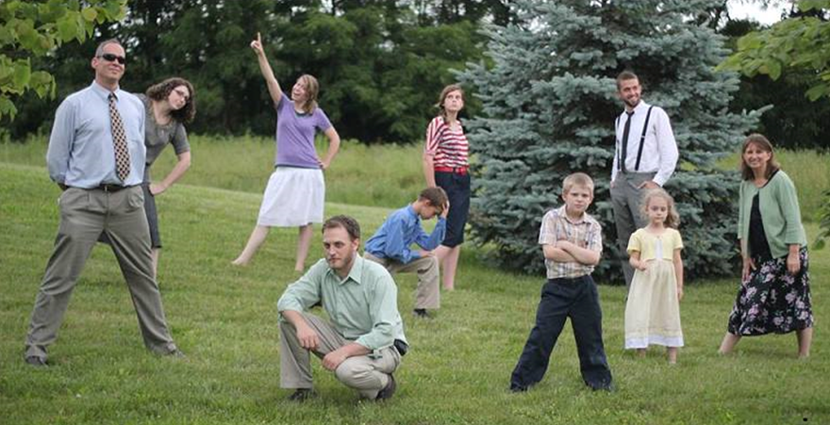
something I’ve needed
& would recommend: the improvement game

Slide 101
ROLES
Josh. 24.15
Eph.5.25
1Ptr. 3; 1Tm.5.14
Eph.6

Slide 102
extra charts

Slide 103
What about
ADHD?

Slide 104
What about
ADHD?

Slide 105
Never spank
your child.
Your son is a problem in class
Don’t be controlling. Let him be himself.
Your son has a behavioral disorder.
Straight correlation? No, not that simple…
Build up his
self esteem.
Here’s a drug
to control the problem.

Slide 106
parenting
& meds

Slide 107
two premises:
Biblical premise
we have physical needs
we have moral, spiritual, & social duties
we are
physical
we are
spiritual
We are created by God.
We are to turn from sin.
We will face judgment.

Slide 108
evolutionary premise
biblical premise
some
adapt
easily to social
constructs
some do not adapt easily to
to social
constructs
we are unplanned accumulations of chemicals
ideas of
God, sin, and judgment are irrelevant myths

Slide 109
GOOD PHYSICIANS
a noble profession…
Mark 2.17 “It is not the healthy who need a doctor, but the sick”
Col. 4.14 “Luke, the beloved physician”
LTD. PHYSICIANS
Mark 5.26 “who had suffered much under many physicians, and had spent all that she had, and was no better but rather grew worse.”

Slide 110
ADHD
familial
component
training
component
gender
component

Slide 111
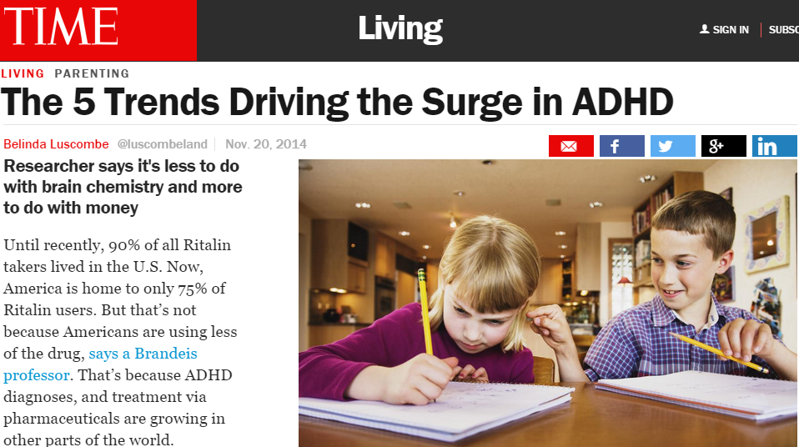
NOV. 2014 http://time.com/3595712/the-5-trends-driving-the-surge-in-adhd/
Until recently, 90% of all Ritalin takers lived in the U.S. Now, America is home to only 75% of Ritalin users.

Slide 112

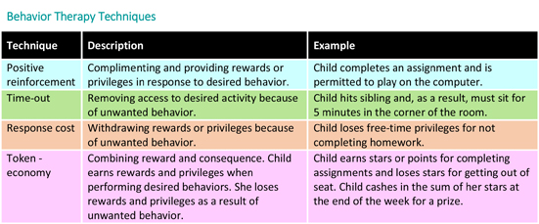
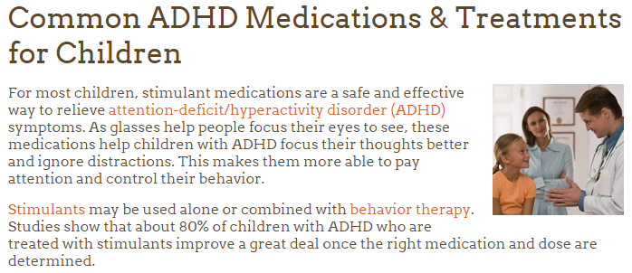
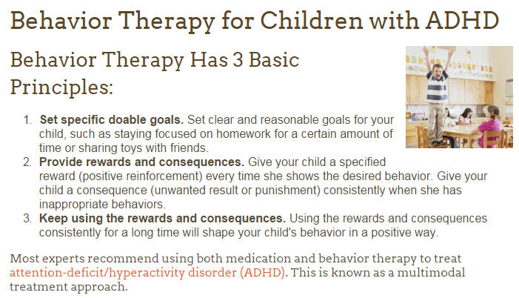
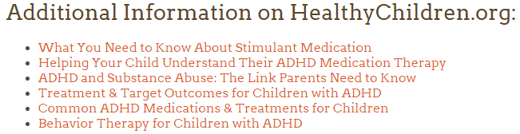
WHY not
use such
therapy for childhood diseases
?
Under this approach, parents, teachers, and other caregivers learn better ways to work with and relate to the child with ADHD. You will learn how to set and enforce rules, help your child understand what he needs to do, use discipline effectively, and encourage good behavior. Your child will learn better ways to control his behavior as a result. You will learn how to be more consistent

Slide 113
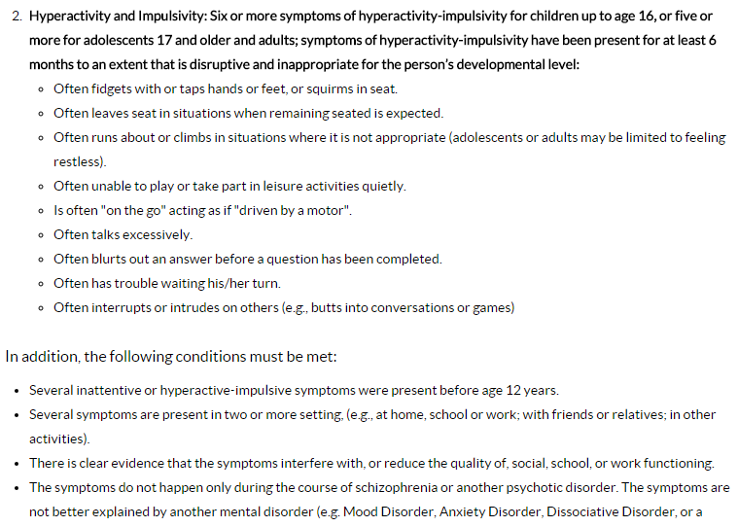
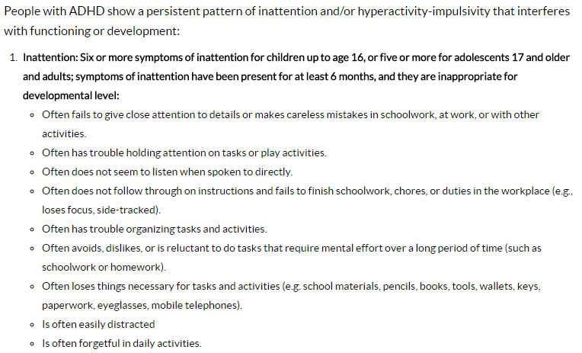
http://www.cdc.gov/ncbddd/adhd/diagnosis.html

Slide 114

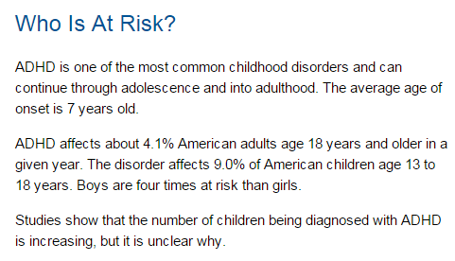

Slide 115
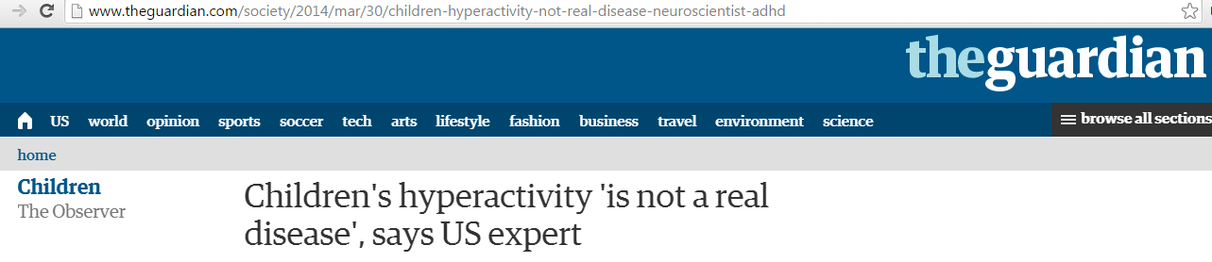
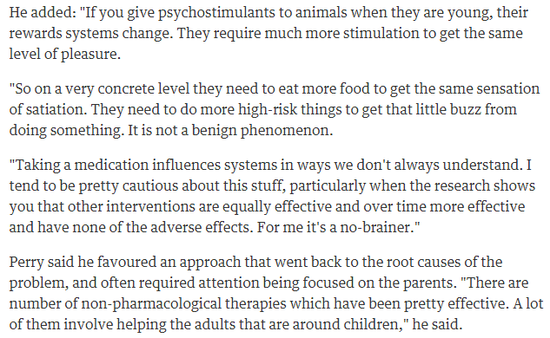
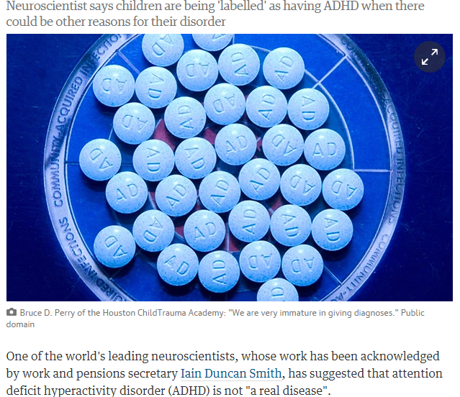
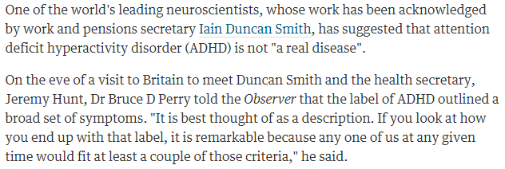

Slide 116
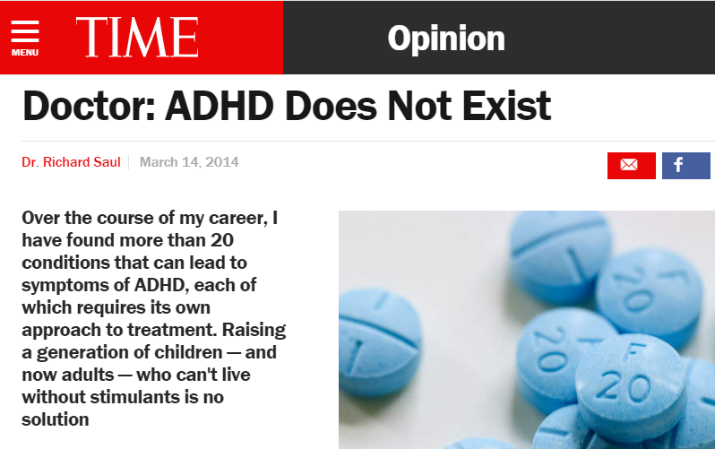
http://time.com/25370/doctor-adhd-does-not-exist/
Over my 50-year career in behavioral neurology and treating patients with ADHD, it has been in the past decade that I have seen these diagnoses truly skyrocket.
First, addiction to stimulant medication is not rare; it is common. The drugs’ addictive qualities are obvious. We only need to observe the many patients who are forced to periodically increase their dosage if they want to concentrate. This is because the body stops producing the appropriate levels of neurotransmitters that ADHD meds replace — a trademark of addictive substances. I worry that a generation of Americans won’t be able to concentrate without this medication; Big Pharma is understandably not as concerned.
Today, the fifth edition of the DSM only requires one to exhibit five of 18 possible symptoms to qualify for an ADHD diagnosis. If you haven’t seen the list, look it up. It will probably bother you. How many of us can claim that we have difficulty with organization or a tendency to lose things; that we are frequently forgetful or distracted or fail to pay close attention to details? Under these subjective criteria, the entire U.S. population could potentially qualify. We’ve all had these moments, and in moderate amounts they’re a normal part of the human condition.
In short, I’ve come to believe based on decades of treating patients that ADHD — as currently defined by the Diagnostic and Statistical Manual of Mental Disorders (DSM) and as understood in the public imagination — does not exist.
Dr. Richard Saul is a behavioral neurologist practicing in the Chicago area. His book, ADHD Does Not Exist, is published by HarperCollins.

Slide 117
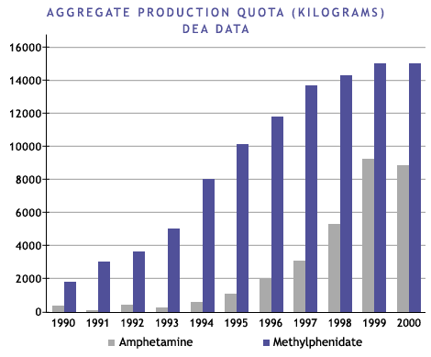
http://www.pbs.org/wgbh/pages/frontline/shows/medicating/drugs/stats.html
The production of methylphenidate (Ritalin) and the legal production of amphetamine in the form of Adderall and Dexedrine in the U.S. has soared since 1990… these drugs are considered to be potential drugs of abuse under the Controlled Substances Act
Source: www.dea.gov/pubs/cngrtest/ct051600.htm

Slide 118
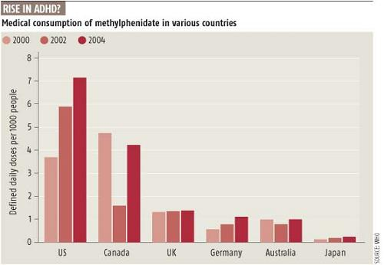
http://scienceblogs.com/retrospectacle/2007/07/27/the-neuroscience-of-adhd-1/

Slide 119

It is tempting to view this pattern as suggesting that the ADHD diagnosis provides teachers with a new technique for regaining control of the classroom in a world where many of the traditional methods of control have been eliminated. Drugs have replaced the reprimand.
… Nor is there any mechanism, of the sort one would find in a school-choice-based system of education, for parents to seek out schools tailored to the temperaments and capabilities of their children… when it is difficult or inconvenient to change the environment, we don't think twice about changing the brain of the person who has to live in it…
None of this should be taken to suggest that there are no cases of genuine brain damage or dysfunction that require medical intervention… But difference does not automatically equal disease. Is changing the child's brain chemistry, by prescribing Ritalin-like drugs, really the most appropriate response to the child who doesn't perform well in the modern school environment?
Imagine yourself sitting in a classroom--say, a fourth-grade social-studies class. There is a teacher at the front of the room, but a groundskeeper mowing grass outside captures your attention instead. When the mower moves away, however, you feel bored and restless. Pretty soon your swinging feet slam into the seat in front of you. The attentive student sitting there yelps and the teacher interrupts the class to ask what the problem is. This sudden activity jolts you back into focus; at least something interesting is happening. You're beyond feeling embarrassed about being the center of this kind of attention. It happens all the time, and you have quite a reputation for this sort of thing. And besides, it isn't really your fault. They all say you probably have ADD or ADHD or something like that and can't help but act this way. It's just the way life is for some kids.
There is something odd, if not downright ironic, about the picture of millions of American school children filing out of "drug-awareness" classes to line up in the school nurse's office for their midday dose of amphetamine.

Slide 120
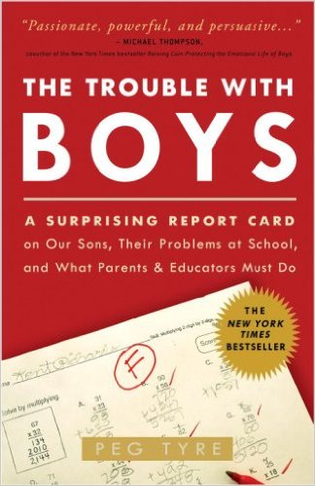
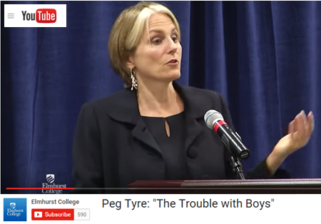
The Trouble with boys, Peg Tyre
2nd graders : hares & tortoises
boys: “reading is kinda girly”
gender & movement
G&B
recess & sitting still
att.: “girls are the gold std. & boys are the defective girls”
teachers: females dominant
maturity rate difference
G
B
< most /\ most >
sedentary avg. active
Developmental Psychology Warren O. Eaton
http://home.cc.umanitoba.ca/~eaton/child-development-motor-activity-level.htm

Slide 121
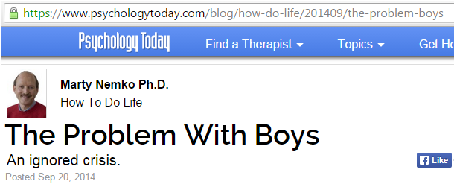
four to eight times as likely to be drugged with Ritalin and other stimulants, which pediatrician Leonard Sax, calls “academic steroids.”
reading much more poorly than are other students.
three times as likely to commit suicide.
2 1/2 times as likely to drop out of high school.
severely underrepresented in college and even more so among college graduates, thereby locking them out of today’s, let alone tomorrow’s professional-level jobs.

Slide 122
And our schools continue to get ever more feminized. Competition, one of boys’ favorite motivators, has largely been excised in favor of “cooperative learning,” (which ends up often meaning hat the bright and dedicated do the dull's and lazy's work.) Stories of heroism and bravery are replaced with tomes about relationships and sheroes. Recess, which active boys desperate seek to release pent up energy is increasingly replaced by yet another round of phonics. Girls are told they can accomplish anything while boys are taught that masculinity is an anti-social trait that must be extinguished.
The percentage of female K-12 teachers has risen to an all-time high: 76.3 percent (link is external). In elementary school, it’s well over 90 percent. The main role model boys see in school is the custodian.
And when boys get home from school, the male role models get worse. Whether watching a sitcom, movie, cartoon, or commercial, the odds are good that the male is a buffoon or sleazebag while the female is savvy and confident.

Slide 123
DOES NOT MEAN:
Let boys get away with bad behavior
Boys can’t sit still
Boys shouldn’t be disciplined
But:
Girls are girls, and boys are boys
Both need parenting, raising, & training
Pr.22.6
Little boys will not stay little boys. Let’s help them grow to be godly young men.
Little girls will not stay little girls. Let’s help them grow to be godly young women.

Slide 124
CHI LD
TRAINING
Therefore a man shall leave his father and his mother and hold fast to his wife, and they shall become one flesh. Gen. 2.24 esv
You shall love the LORD your God with all your heart and with all your soul and with all your might. And these words that I command you today shall be on your heart. You shall teach them diligently to your children, and shall talk of them when you sit in your house, and when you walk by the way, and when you lie down, and when you rise. Deut. 6.5-6 esv
The rod and reproof give wisdom, But a child who gets his own way brings shame to his mother. Prov. 29.15 nasb
Correct your son, and he will give you comfort; he will also delight your soul. Prov. 29.17 nasb
Train up a child in the way he should go, Even when he is old, he will not depart from it. Prov. 22.6 esv
Older women… teach what is good …train the young women to love their husbands and children… working at ome…submissive to their own husbands Titus 2.4-5 esv
Fathers, do not provoke your children to anger, but bring them up in the discipline and instruction of the Lord. Eph.6.4 esv

Slide 125
LOVE
Eph.5.25;
Titus 2.4

Slide 126
PARENTS
Proverbs 22.6
“Train up a child in the way he should go,
Even when he is old, he will not depart from it”

Slide 127
husbands
& wives
e x a m p l e :

Slide 128
Husband
Gen. 2.18, 24 leave & cleave (Mk.10; Mt.19)
provider:
Gen.3.13-19; 1 Tim. 5.8 provide for physical needs
Eph. 5.25, 28-29; 6.1-4 provide leadership generally

Slide 129
sacrificial leadership
Eph.5:23-25 cf. Mt. 20,25-28
Husband
For the husband is the head of the wife, even as Christ is the head of the church: and he is the savior of the body….
Husbands, love your wives, even as Christ also loved the church and gave himself up for her ”

Slide 130
Eph. 5 husband: wife: love her follow him

Slide 131
LOVE
RESPECT

Slide 132
“one”
Eph.5:28-31
Husband
Even so ought husbands to love their own wives as their own bodies. He that loves his own wife loves himself, for no man ever hated his own flesh, but nourishes and cherishes it … for this cause shall a man leave his father and mother, and shall cleave to his wife, and the two shall become one flesh”

Slide 133
remembering your vows:
“cherish” Eph.5.28-29
“honor” 1Ptr.3.7 (& dwell w/ here w/ understanding)
“to her and her alone” Job.31.1; Pr.5; Mt.5
“love” Eph. 5.28
“Husbands, love your wives, even as Christ also loved the church and gave himself up for her… Even so ought husbands to love their own wives as their own bodies. He that loves his own wife loves himself”
Husband

Slide 134
Pr. 18.22
“He who finds a wife finds a good thing”

Slide 135
Prov. 14.1 nasb
The wise woman builds her house, But the foolish tears it down with her own hands.
Prov. 21:9 & 19

Slide 136
Research shows no long term benefit from ADHD medication – abc.net (australian TV) abc.net.au/worldtoday/content/2007/s2089497.htm
Professor William Pelham from the State University of New York at Buffalo has been involved in a national study on ADHD treatment since the 1990s.
WILLIAM PELHAM: We published a report in 1999 that appeared to suggest that medication was the best way to treat children with ADHD. Other treatments were also good, that is a psychosocial approach, training parents and children and teachers how to work together, but medication appeared to be a bit better and we published that.
And then a year later did follow up, and two years later did another follow up, and that was just reported. And each time we did follow up, the effects of medication were less and less. And this last follow up, we can no longer detect any beneficial effects of medication.
The explosion in ADHD diagnosis and treatment with stimulants such as Ritalin (Methylphenidate) represents the greatest medical catastrophe since Thalidomide -B.Turner Lecturer in Legal Studies in Forensic Science in the Department of Biological Sciences, University of Lincoln, UK, counselingonlinesite.com/blog/archives/2009_03_01
PBS.COM > search: BRAIN POLITICS

Slide 137
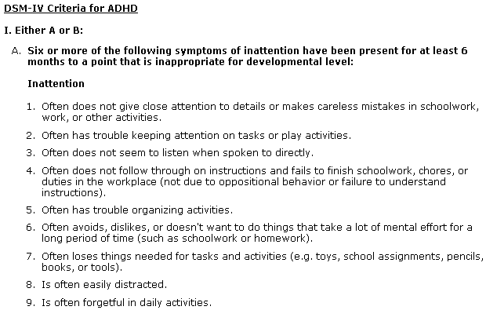
www.cdc.gov
1. Often does not give close attention to details or makes careless mistakes in schoolwork, work, or other activities.
2. Often has trouble keeping attention on tasks or play activities.
3. Often does not seem to listen when spoken to directly.
4. Often does not follow through on instructions and fails to finish schoolwork, chores, or duties in the workplace (not due to oppositional behavior or failure to understand instructions).
5. Often has trouble organizing activities.
6. Often avoids, dislikes, or doesn't want to do things that take a lot of mental effort for a long period of time (such as schoolwork or homework).
7. Often loses things needed for tasks and activities (e.g. toys, school assignments, pencils, books, or tools).
8. Is often easily
distracted
9. Is often forgetful
in daily activities.

Slide 138
http://www.cdc.gov/ncbddd/adhd/diagnosis.html

Slide 139
The Homes We Need
Built with the Lord
Ps. 127:1
Built on the word
Mt. 7:24-27
Built in sanctification
Josh. 24:15; Dt. 6:4-9; Jas. 4:4

Slide 140
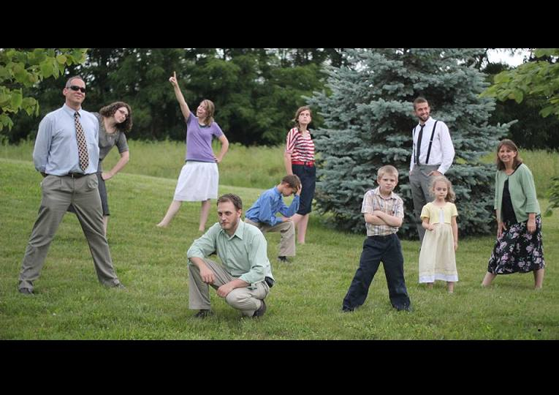

Slide 141

